Slide 1



Design of a Simple Test Fixture for a Powered Foot-Ankle Prosthesis
By: Isaac Romero
Faculty Mentor: John T. Tester, Ph.D.

Slide 2
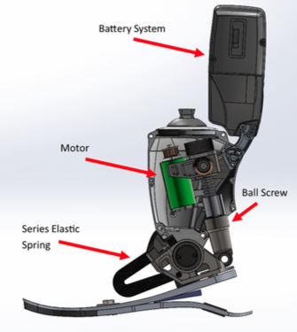
Introduction
NAU researchers in biology and engineering conduct research projects in muscle modeling and human gait analysis.
One experimental platform used is the commercially available BiOM prosthesis which is a powered, foot-ankle system [1].
Isaac Romero
[1]Petak, JL. Provide title. Masters thesis. Northern Arizona University. 2015

Slide 3
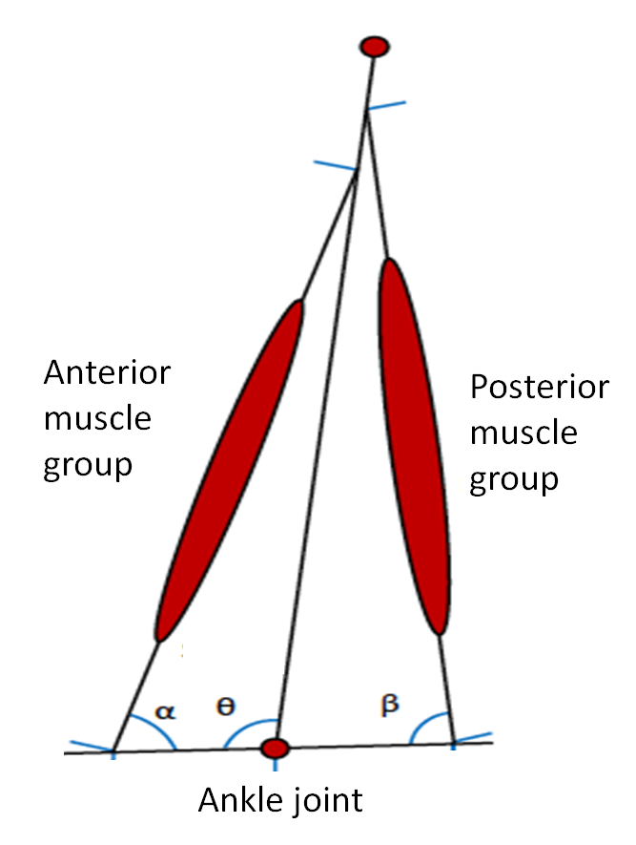
Introduction
NAU researchers are modifying the BiOM control software.
    Control algorithms revisions are frequent because of adjusted muscle model adaptations
    Revisions include hard-coded user parameters
    Verification testing before subject use
Control algorithm code
Isaac Romero

Slide 4
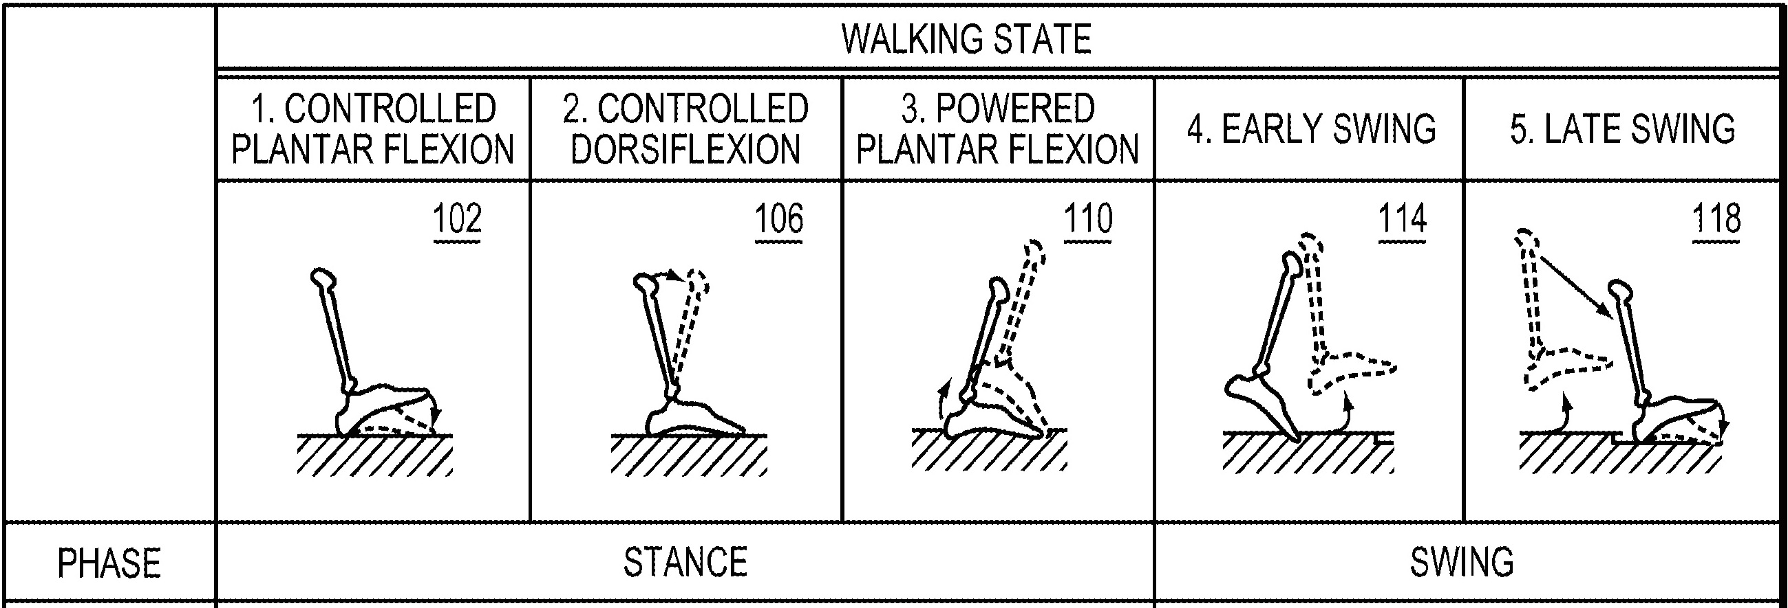
Problem Statement
Need for a physical testing fixture to conveniently test updated control software revisions
Design a test system that is simple to apply and control.
    Mimic a simple calibration test output with repeatable output data (ankle angle and ankle torque)
    Enable future updates to the test system that allow for more complex motion input on the foot bed [3].
[3] Herr, H. 2011. ”Controlling torque in a prosthesis or orthosis based on a deflection of series elastic element”, U.S. Patent 20110295385a1.
Isaac Romero

Slide 5
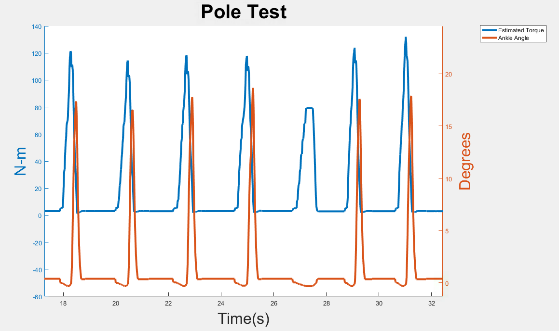
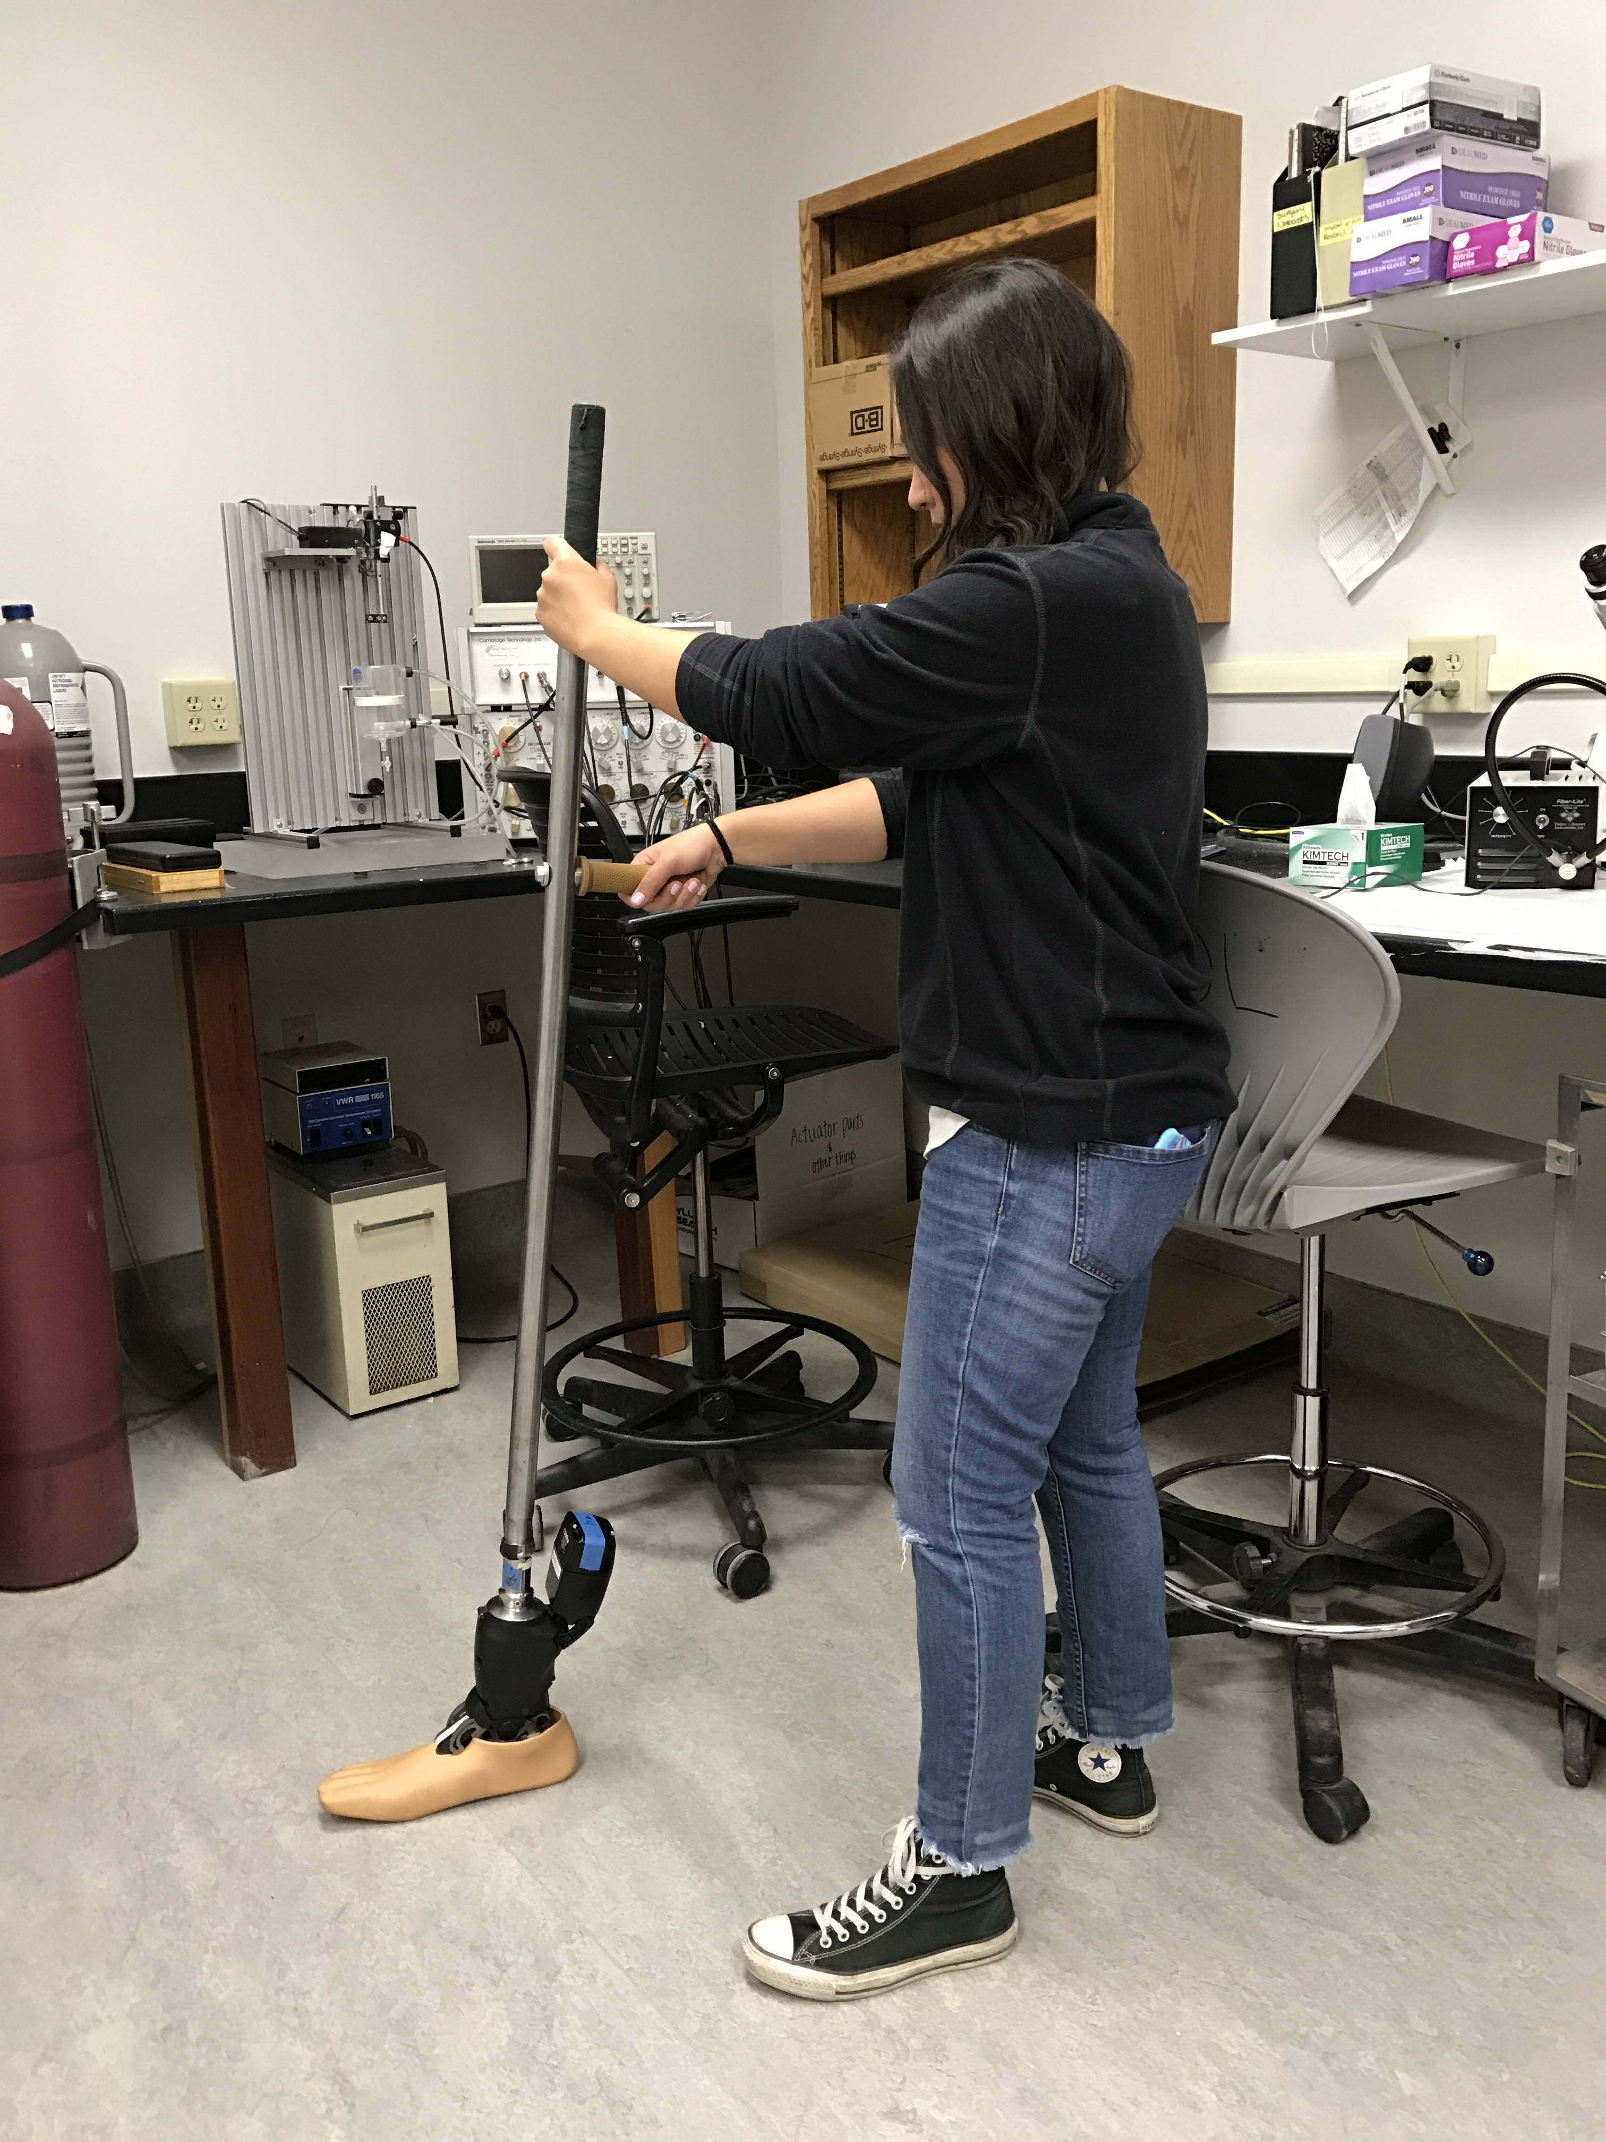
Purpose
Test Logistics: Challenging to schedule subjects with trans-tibial amputations
Robotic ankle needs to be tuned prior to subject arrival
Previous testing format: Pole Test
    Not a repeatable test and results in inconsistent data.
    Researchers struggle to apply an appropriate amount of force
Isaac Romero

Slide 6
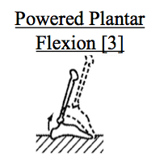
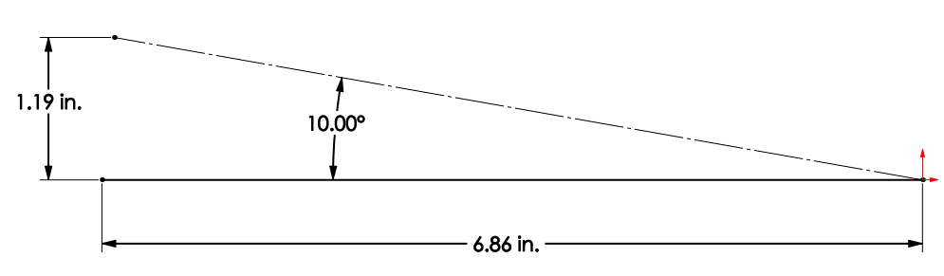

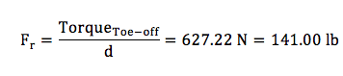
Methods
A single displacement step function is required for input to the system.
    Displacement stroke obtained from robotic ankle geometry and angle of foot rotation.
The max force required to stimulate powered plantar flexion (toe off) was obtained from past level walking experiments with subjects.
Isaac Romero

Slide 7
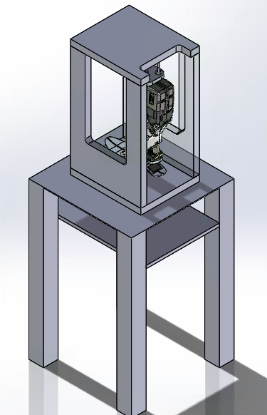
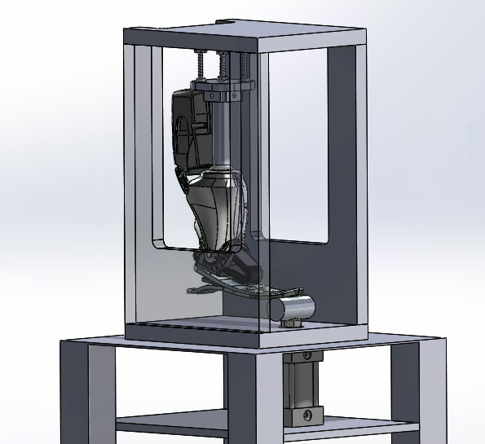
Design Characteristics
Pneumatic piston actuator
    double action
    controlled by single solenoid valve
    Stimulate toe off reaction
Compliant pylon connection
    absorb transverse and normal forces
Isaac Romero

Slide 8
Anticipated Results
Robust experimental platform
    Record repeatable output data
Provide a variable force to simulate different subject parameters
    weight
    foot size
    limb length
Allow for test fixture updates
    All five stages of level walking
Isaac Romero

Slide 9
Acknowledgements
Faculty mentor: Dr. John Tester
Arizona NASA Space Grant Consortium
    Dr. Nadine Barlow
    Kathleen Stigmon
RAPIDLab at Northern Arizona University
NAU Center for Bio Engineering Innovation
Isaac Romero

